Slide 1
Lecture:
The Rise of Socialism, -350 to 1917
Brad DeLong
Department of Economics & Blum Center, U.C. Berkeley; & WCEG
last revised: Th 2020-04-03
for presentation: Tu 2020-04-07
<https://github.com/braddelong/public-files/blob/master/lecture-rise-of-socialism--350-1917.pptx>
<https://www.icloud.com/keynote/0tIKCGGDU9duGkZ7XQ_5GkPdg>
text: <https://github.com/braddelong/public-files/blob/master/lecture-rise-of-socialism--350-1917-text-pdf>

Slide 2
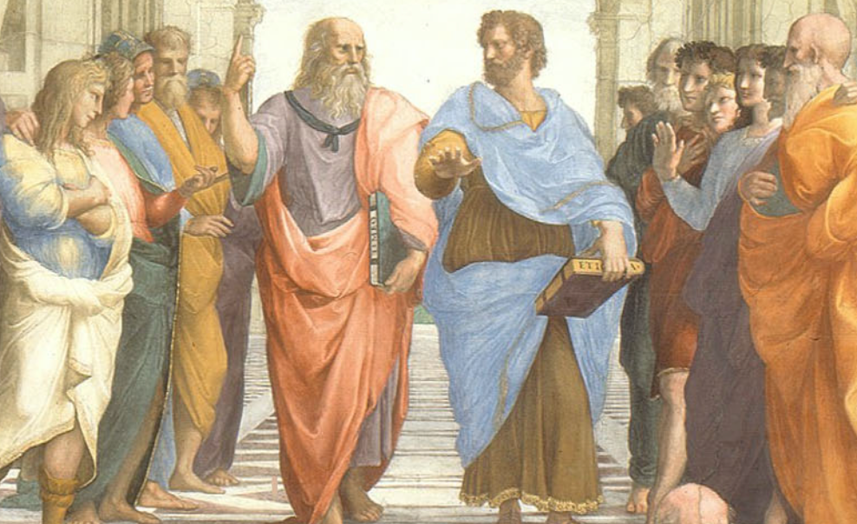
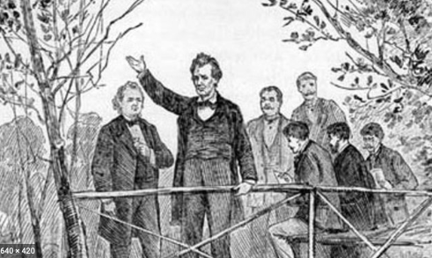

The Rise of Socialism, -350 to 1917
From -350 to 1917:
Ancient assumptions about inequality
The coming of enlightenment utilitarian values
The question of the proper political order: fears of democracy
Yet democracy and fundamental equality came
Popular government and the market economy: the tension
Technological cornucopia
Popular resistance to industrial socialist ideals
Political democracy insufficient for utopia
An example: governing Chicagoland
Left-wing European politics before World War I
40 minutes of audio
1:30
Notes:
Let’s talk about the rise of socialism, with a focus on the rise of really existing socialism, the system that lived behind what Winston Churchill called the Iron Curtain from 1917-1991, that shook the world, and that in the end turned out to be far, far, far from the brightest light on the tree of humanity’s good ideas. So let’s very briefly race through history—moral, intellectual, political, and social—from the year -350 to the year 1917, when Lenin and his Bolshevik Communist Party staged their coup in Russia, in order to set the stage for that discussion.

Slide 3
Ancient Assumptions About Inequality
Aristotle in the -300s:
Many people “slaves by nature”
This is fortunate, for slavery necessary if there is to be a good society
So it is, and so it always would be
For it is not so only with the mythical technologies of the Golden Age, or of the gods
Even Abraham Lincoln in the mid-1800s:
“I have no purpose to introduce political and social equality between the white and the black races…. I agree with Judge Douglas [that the Negro is not my equal in many respects—certainly not in color, perhaps not in moral or intellectual endowment…”
(But Lincoln then has a “but”:
“There is no reason in the world why the negro is not entitled to all the natural rights enumerated in the Declaration of Independence…. In the right to eat the bread, without the leave of anybody else, which his own hand earns, he is my equal and the equal of Judge Douglas, and the equal of every living man…”
4:30
Notes:
There was a profound shift from the belief in “divine right” and “natural order” as the fundamental grounding for an unequal society to enlightenment values—that human institutions should be rationally designed on the basis of a rational understanding of human psychology in order to attain the greatest good of the greatest number, and thus that inequality is not given by the gods or by the requirements of nature, but rather is a thing to be allowed to the extent that it incentivizes cooperation and industry and thus enriches us all.
Back in the century of the -300s, Aristotle had taken it for granted that a good society was only possible if the society allowed for philosophy. And philosophy was only possible if you had a leisured upper class. And a leisured upper class was possible only with large scale-unfree labor—serfdom, or its harsher cousin slavery. Thus it was and thus it would always, be unless and until humans obtained the fantasy technologies of the mythical Golden Age. That was what Aristotle wrote: that “chief workmen would not want servants, nor masters slaves” only if:
>every instrument could accomplish its own work, obeying or anticipating the will of others, like the [blacksmithing] statues of Daedalus, or the three-wheeled catering serving-carts of Hephaestus, which, says the poet: "of their own accord entered the assembly of the Gods”… the shuttle would weave and the plectrum touch the harp without a hand to guide them…
Thus it was fortunate that:
>It is manifest therefore that there are cases of people of whom some are freemen and the others slaves by nature, and for these slavery is an institution both expedient and just…. There exist certain persons who are essentially slaves everywhere…. Slavery for the one and mastership for the other are advantageous and just, and it is proper for the one party to be governed and for the other to govern by the form of government for which they are by nature fitted, and therefore by the exercise of mastership…
And even in the middle of the 1800s, Abraham Lincoln thought it prudent in the Lincoln-Douglas debates to give a bow to the belief that humans were unequal, grossly unequal, by command of nature or of God:
>I have no purpose to introduce political and social equality between the white and the black races. There is a physical difference between the two, which, in my judgment, will probably forever forbid their living together upon the footing of perfect equality, and inasmuch as it becomes a necessity that there must be a difference, I, as well as Judge Douglas, am in favor of the race to which I belong having the superior position…. I agree with Judge Douglas he is not my equal in many respects—certainly not in color, perhaps not in moral or intellectual endowment…
Before turning on a dime, and making his main point after a “but”:
>There is no reason in the world why the negro is not entitled to all the natural rights enumerated in the Declaration of Independence, the right to life, liberty, and the pursuit of happiness…. In the right to eat the bread, without the leave of anybody else, which his own hand earns, he is my equal and the equal of Judge Douglas, and the equal of every living man…
Moreover, humanity was bout to begin to gain the autonomous robotic blacksmithing statues of master-craftsman Daedalus—and more, a thousand-fold—and also food-production, food-processing, and food-distribution technology vastly outstripping the self-propelled catering carts of Hephaestus the smith-god. Our shuttles now weave without hands to guide them. And as for the need for a hand to guide each making of a musical note—well…
Thus between 1870 and our day it ceased to be a necessity to own or to have some direct or indirect dominion over slaves and near-slaves in order to be rich in material terms and thus approach utopia.

Slide 4
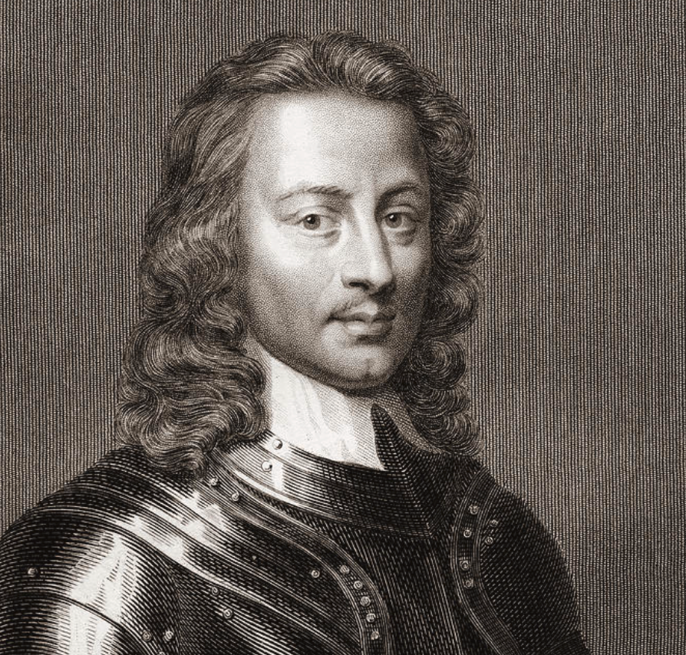
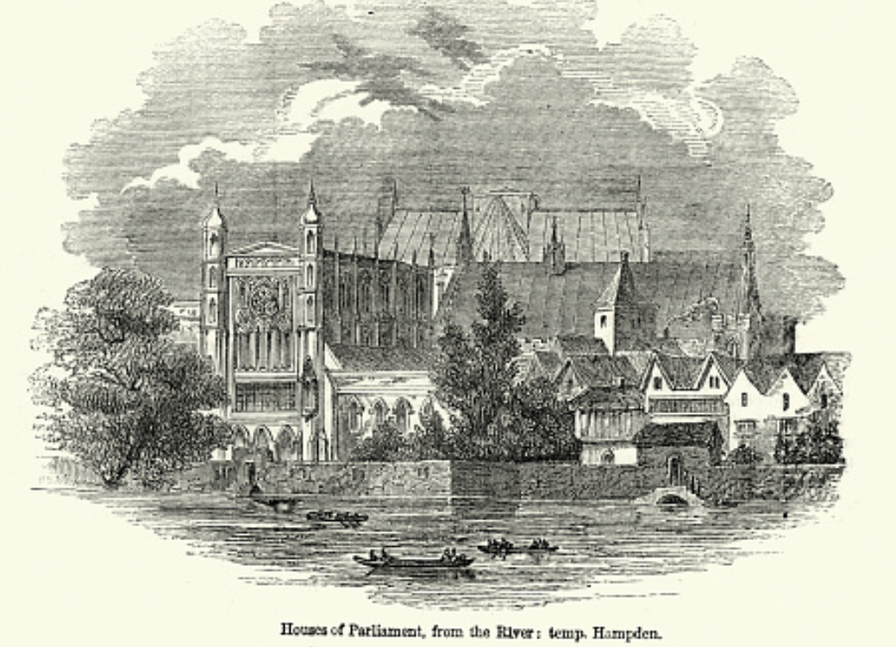
Enlightenment Utilitarian Values
Pre-1870: From “Divine Right” and “Natural Order” to Enlightenment values…
Who was the first person to draft these words:?
John Locke
Niccolo Machiavelli
Thomas Hobbes
Thomas Jefferson
George Washington
“We hold these truths to be sacred & undeniable:
that all men are created equal & independant,
that from that equal creation they derive rights inherent & inalienable,
among which are the preservation of life, & liberty, & the pursuit of happiness;
that to secure these ends, governments are instituted among men, deriving their just powers from the consent of the governed…”
Why did he write them?
2:30
Notes:
Who was the first person to write down words like these?:
>We hold these truths to be sacred & undeniable: that all men are created equal & independant, that from that equal creation they derive rights inherent & inalienable, among which are the preservation of life, & liberty, & the pursuit of happiness; that to secure these ends, governments are instituted among men, deriving their just powers from the consent of the governed…
If people do not consent and believe that the government is vindicating their inherent and inalienable rights that they derive from their equal and independent creation, then it is a sacred and undeniable truth that that government—and the societal order it supports and maintains—is no true government at all.
Do you think the writer was John Locke, Niccolo Machiavelli, Thomas Hobbes, Thomas Jefferson, or George Washington?
Yes, it was Thomas Jefferson in the year 1776.
This is the opening of his first draft of the Declaration of Independence of the United States of America: the glorious statements of (a) fundamental human equality, and (b) equal human rights—to life, liberty, and then what usually shows up as “property” but which TJ called “pursuit of happiness”. Perhaps he wrote it thus to make it broader than just a right to own property and turn it into a right to have one’s own sphere of autonomy within which one could form plans and try to accomplish them to pursue one’s happiness. That broader right simply could not be accomplished by a narrow right to own property, but required and requires much broader support.
But perhaps is was to make the right narrower.
In Virginia in 1776 to assert that it was a “sacred and undeniable” truth that “all men” had an “inherent and inalienable” right to one property would cast considerable shade on the key Virginia institution of slavery—for the slaves had, in Virginia mythology, not only alienated their own inalienable right to own property, but they had alienated their children’s right to own property and their own and their descendants rights to be anything but property.
However, here we are interested in the shift in ideals to enlightenment utilitarian values, rather than in the hypocrisy of the gap between ideals and reality.

Slide 5
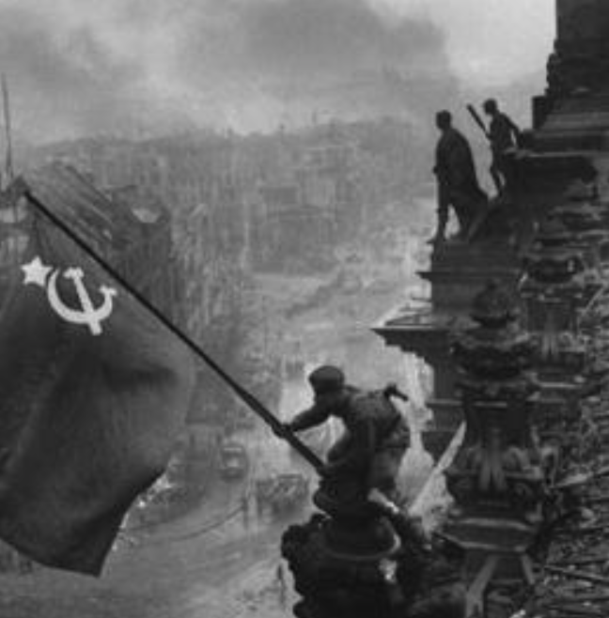
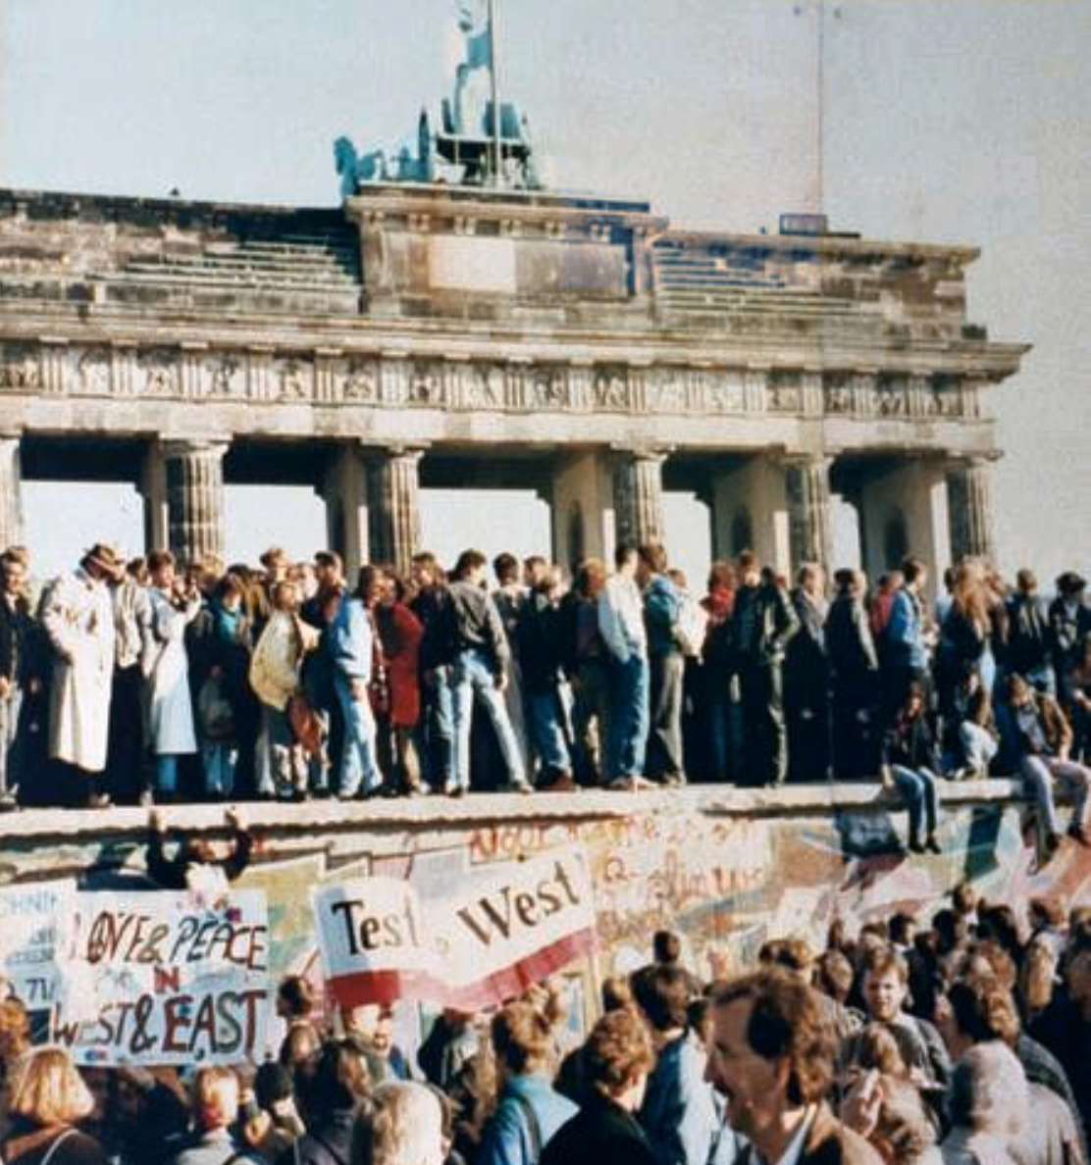
What Was the Proper Political Order?
Fears of “democracy” among American founders:
Madison: “Democracies have ever been spectacles of turbulence and contention... incompatible with personal security or the rights of property... as short in their lives as... violent in their deaths…”
Jefferson: “Gen’l Washington had not a firm confidence in the durability of our government… [& this] had some weight in his adoption of… ceremonies… calculated to prepare us gradually for a change which he believed possible…”
Hamilton: “the British government… best” as the only one “unit[ing] public strength with individual security…”
Adams: The American president should be announced as: “His Highness, the President of the United States, and Protector of the Rights of the Same…”
Question of political order thought settled: first in the rubble of Berlin in 1945, and then in the streets of East Germany in 1991:
Settled in favor of representative democracy, private property, & social insurance—late-1900s liberal democracy
But now reopened? Min Zhu (朱民) to me in 2015: “What are you Americans going to do to fix your broken political system?”
4:00
Notes:
However, accepting the enlightenment values of the U.S. Declaration of Independence—that governments are instituted among humans to vindicate their rights to life, liberty, and the pursuit of happiness; and that governments that do not vindicate those rights and to which humans thus do not consent are no true governments at all—does not give much guidance to what kind of government should be instituted, and what kind of societal order it should support.
In the late 1700s James Madison had not been enthusiastic about democracy:
>Democracies have ever been spectacles of turbulence and contention... incompatible with personal security or the rights of property... as short in their lives as... violent in their deaths…
James Madison had been enthusiastic about a republic. People who counted were to choose a small, select group of representatives who had their values and well-being at heart, but not their passions or their interests. Representatives would then govern subject to procedural checks-and-balances. Under Madison and company’s America constitution, remember, states could restrict the franchise as much as they wished—as long as it preserved “a republican form of government.”
James Madison’s suspicions had been widely shared. His one-time friend and co-author Alexander Hamilton even held that a constitutional monarchy—in which the monarch, the aristocracy, and the masses all held real power to balance one another—was the best of all attainable governments, with “the British government… best” as the only one “unit[ing] public strength with individual security…” And Thomas Jefferson suspected George Washington thought Hamilton was right, and that the American republic might fail: “General Washington had not a firm confidence in the durability of our government”. Jefferson thought this fear “had some weight in his adoption of… ceremonies… calculated to prepare us gradually for a change which he believed possible.” And John Adams proposed that the American president be announced as: “His Highness, the President of the United States, and Protector of the Rights of the Same”.
We had thought that the questions of political order had been settled first in the rubble of Berlin in 1945, and then in the streets of East Germany in 1991: We had thought they had been settled in favor of representative democracy that balanced off interests and got as close as possible to the will of the median voter necessary for proposals to command majority assent, while having sufficient constitutional checks-and-balances to ensure the protection of minority rights. (Rather than a “leadership state” in which popular unity was created by obeying the commands of a visionary ruler). We had thought they had been settled in favor of private property, a mixed economy, and social insurance. (Rather than either a laissez-faire “free to starve” system or a command economy directed by the elite cadres of a ruling party that possessed the intellectual key to the lock that guarded the riddle of historical development. )
We had thought that the questions had been settled in favor of constitutional representative and liberal democracy, plus a private-property market-heavy mixed economy with social insurance.
But are these now reopened? As senior Chinese leader Min Zhu (朱民) said to me—with absolutely no trace of irony at all—back in 2015: “What are you Americans going to do to fix your broken political system?”

Slide 6
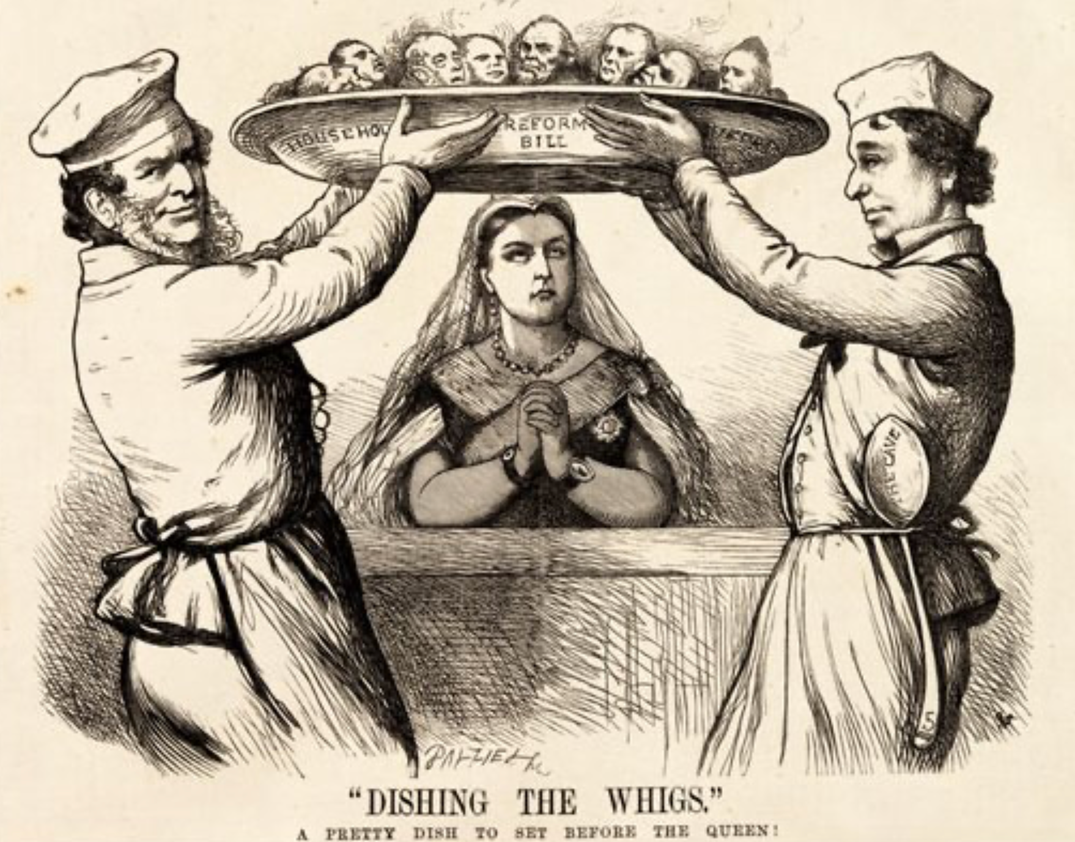
Yet Democracy and Fundamental Equality Came…
Franchise Restricted to the Rich Could Not Maintain Itself:
The dynamic of franchise extension
Liberals in power would try extend on the principle that the new, poorer voters would be less conservative and would support them.
Threatening revolution would lead even conservatives to seek to extend the franchise in order to peel off of the revolutionary coalition those of the disenfranchised who had the most social power:
Earl Grey (yes, the tea): “The Principal… is to prevent… revolution…. I am reforming to preserve, not to overthrow…”
Charismatic leaders with popular followings would seek to give them votes, and then rule via plebiscites—going around the traditional elites
(Peculiar thing about Trump-Johnson: minority, and core is a minority of a minority…)
Conservatives: “dish the Whigs”—opportunities to form winning coalitions by appealing to those who were no profiting from the market economy, or felt that they were losing relative status in some ways…
5:15
Notes:
In spite of fears about the instability and irrationality of democracies and the desirability of keeping politics in the hands of sober successful people with property, as the 1800s moved forward, democracy—at least in the form of one male of the right age and race, one vote—as the touchstone of political legitimacy made massive strides, if at deliberate speed. Claims that kings ruled by divine right and that aristocracies ruled by virtue of their ancestors having been among those who conquered the Anglo-Saxons with William of Normandy or the Romano-Gauls with Clovis the Frank became increasingly risible and ran aground. So many aristocrats were noble because their ancestors had been fixers, pimps, or bureaucrats for past kings.
For a while prosperity was an alternative touchstone: rulers should be elected or at least advised by those selected by vote, yes, but by a vote of the prosperous. François Guizot, left-of-center Prime Minister of France’s constitutional monarchy in the early 1840s, responded to demands for a broader electoral franchise with the words “enrichessez vous”: if you want to vote, get rich enough that you qualify. It did not work. On February 23, 1848, King Louis-Philippe of France’s Orleanist dynasty—the only king of the Orleanist dynasty—threw Guizot over the side in the hope of avoiding revolution and dethronement. Louis Philippe abdicated the following day.
Worldwide, politicians on the left wanted, eventually, more than one person-one vote. They sought the abolition of private property and the rational distribution of the products of the societal division of labor… well, by it was not clear what. But that position was rejected by the bulk of political society: only rarely could it win any majorities for its position that the government should have a totalizing role—that all questions should be settled and all social life organized by a government, in which each one counted for one and one alone.
Worldwide, politicians on the right held the view that some existing inequalities of wealth, influence, and political power were just or holy or both. But they were divided. Some viewed inequalities emerging from the creative destruction and accumulation of the market with, at best, suspicion. Others viewed inherited and status inequalities with grave suspicion. Some tried to reconcile and exalt all the groups of inheritors, entrepreneurs, and crony capitalists, but that was a difficult balancing act.
Thus the balance point was in the middle. Over the 1800s the political principle that caused the least offense to the greatest number being that political society would be a realm in which some or most of the male individuals’ preferences counted equally in choosing the government, and that the government would then curb and control the economy, to limit but not extinguish the extra influence of those whom American Republican President Theodore Roosevelt called the “malefactors of great wealth” early in the 1900s.
When the left of center was in power they would try extend on the principle that the new, poorer voters would be less conservative and would support them.
When conservatives were in power they might convince themselves to extend the suffrage, on the grounds that the workers were loyal to king and country, were being exploited by the merchant, manufacturing, and commercial agricultural classes, and would be grateful: it would “dish the Whigs”.
When revolution threatened, governments fearing armed mobs in the streets would decide that franchise extension would divide the potentially-revolutionary opposition: “The Principal… is to prevent… revolution…. I am reforming to preserve, not to overthrow,” said Earl Grey in the debate over the 1831 franchise-extension reform bill.
Thus extension of the suffrage tended to creep forward, step by step. Up until 1913, at least in the increasingly prosperous North Atlantic industrial core of the world economy, the prospects for increasing and stabilizing democracy looked good.
Franchise expansions put real power in the hands of poorer and less aristocratic voters—or, rather, of those they chose as their representatives. Thus even aristocrats sought to make them able to wield that responsibility. British cabinet member Robert Lowe argued that after making the richer segment of the working class the masters of the government: “we must educate our masters”.
Sometimes—as with Britain’s Benjamin Disraeli, or Germany’s Otto von Bismarck—conservatives even led the way in extending the franchise, thinking that poor rural voters had more in common with landlords than with plutocratic industrialists and the urban bourgeoisie; and that poor urban voters would hate those who screwed down their wages more than those who sought to preserve ties of authority and respect between rich and poor.

Slide 7
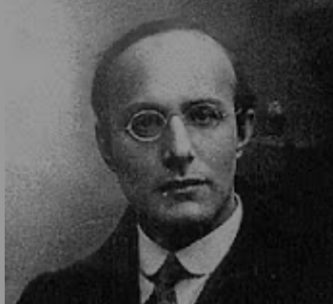
Popular Government and the Market Economy: The Tension
Karl Polanyi
People believe they have rights—to stable, supportive, nurturing communities; to incomes commensurate with their skills and status; and to money flows that will provide economic stability…
But a market society turns these things—land, labor, and finance—into commodities…
But they are not real commodities, they are fictitious commodities
And so you get your rights only if they satisfy a market profitability test
The only rights a market society respects are property rights:
& the only property rights that are worth anything are those that help you produce things for which rich people have a serious jones
Society will have its revenge: it will protect itself against the market logic, somehow, some way…
7:15
Notes:
There was or would be great tension between the political voice and power that came with one man-one vote democracy and the market economy.
In a later day, Friedrich von Hayek always argued that to inquire whether a market economy’s distribution of income and wealth was “fair” or “just” was to commit a fatal and basic intellectual blunder. “Justice” and “fairness” of any form requires that you receive what you deserve. But a market economy gives not to those who deserve well,. T but rather those who happen to be in the right place at the right time to control resources that are valuable for future production. Once you step into the morass of “social justice”, Hayek believed, you would be forced into adjustment after adjustment. You would not be able to stop chasing a “just” and “fair” outcome “until the whole of society was organized… in all essential respects… [as] the opposite of a free society.”
Note that Hayek did not believe (much) in inherited feudal, guild, and customary blockages to decentralized market exchange: they should be steamed away. Then the market would giveth; the market would taketh away; and blessed would be the name of the market. That a market economy can produce a highly unequal and can produce a less unequal distribution of income and wealth was besides the point. We lacked and would always lack the knowledge to create a better society.
The only rights the market economy recognizes are property rights—and then it only recognizes those property rights that are valuable, and the most valuable property rights are those useful in making things for which the rich have a serious jones.
Yet people thought they had other rights than just the rights that accrued to the property they happened to hold. They had bigger and more fundamental objections to a market society than just the objection that it makes some rich and others poor.
Hungarian-Jewish moral philosopher Karl Polanyi wrote during World War II in his book The Great Transformation, not everything is or can be a commodity: making some things into commodities is a fiction. A market society will thus face a backlash—it can be a left-wing, it can be a right-wing backlash, but there will be a backlash, and it will be powerful. Polanyi wrote about how land, labor, and finance were “fictitious commodities” that could not be governed by the logic of profit-and-loss but had always and needed to be embedded in society and managed by the community taking account of religious and moral dimensions. These were—are—brilliant insights. But in The Great Transformation they are incomprehensible to an overwhelming proportion of those who try to read Polanyi.
Let me try to put it better:
The market economy believes that the only rights that matter at all are property rights. The market economy believes that the only property rights that matter a lot are those that produce things for which the rich have high demand.
But people believe that they have other rights:
* With respect to land, people believe that they have rights to a stable community: that the natural and built environment in which they grew up or that they made with their hands is theirs, whether or not market logic says it would be more profitable and lucrative if it were different or if somebody else lived there.
* With respect to labor, people believe that they have rights to a suitable income: they have prepared for their profession, they have played by the rules in so doing, and so society owes them a fair income commensurate with their preparation, whether or not the world market’s logic says that what they make has a free-market price that can support that income or not.
* With respect to finance, people believe that as long as they do their job of working diligently, the flow of purchasing power through the economy should be such as to give people the wherewithal to buy. The decisions of rootless cosmopolite financiers who may be thousands of miles away that this or that flow of purchasing power through the economy is no longer sufficiently profitable, and so should be shut off, should not be able to make your job dry up and blow away.
Note that these rights that society will attempt to validate do not—or might not—be rights to anything like an equal distribution of the fruits of industry and agriculture. And it is probably wrong to describe them as fair: they are what people expect given a certain social order of society. A market order that generates wages seen as too high for Chinese immigrants and opportunities seen as insufficient for white Californians seeking jobs in agriculture will call forth riots and a Chinese Exclusion Act in California late in the 1800s. A market order that generates too much Polish spoken on too many German-owned farms in the early 1900s will start German right-wingers thinking about the drang nach osten, by which the military-religious order of the Teutonic Knights pushed the German-Slavic language frontier a couple of hundred miles east in the Middle Ages. A market order that replaces blue-collar assembly-line worker jobs with robots while generating new jobs only in big liberal cities early in the 2000s will generate “economic anxiety”.
But society will not like the tension between the market economy and its beliefs about the rights governments should vindicate. And as, with one man-one vote, society rather than its comfortable upper stratum gains political voice, it will seek a political solution: it will seek something that people will call “socialism”.

Slide 8
Popular Resistance to Industrial Socialist Ideals
The June Days of 1848 in Paris:
Tocqueville:
“The insurrection of June [1848]... class against class... a blind and rude, but powerful, effort on the part of the [urban] workmen to escape from the necessities of their condition, which had been depicted to them as one of unlawful oppression…. The closing of the national workshops… occasioned the rising…”
“Thousands… hastening to our aid from every part of France.... Thanks to the railroads, some had already come from fifty leagues’ distance... every class of society... peasants... shopkeepers... landlords and nobles all mingled together... they rushed into Paris with unequalled ardour: a spectacle as strange and unprecedented in our revolutionary annals.... The insurgents received no reinforcements, whereas we had all France for reserves…”
1:45
Notes:
Left-wing socialists believed that the backlash to the market would produce overwhelming popular revolutionary demands for a government to take control of the economy and guarantee jobs at equal and fair wages for all. They were to be surprised and astonished when the mass of the people disagreed.
We first saw this in 1848, in the June days of Paris. Urban workers wanted the government to guarantee full employment and fair wages in publicly-funded and -run urban workshops. They sought to overthrow the government. They found that the peasants disagreed: The peasants had gotten their farms in the Great French Revolution half a century earlier. They did not want urban workers to seize control and force them to pay higher taxes to support urban layabouts who ought to go back to their families’ farms when there was no work in the city.
French intellectual and politician Alexis de Tocqueville was amazed. He wrote of:
>The insurrection of June [1848]... class against class... a blind and rude, but powerful, effort on the part of the [urban] workmen to escape from the necessities of their condition, which had been depicted to them as one of unlawful oppression…. The closing of the national workshops… occasioned the rising….
>Thousands… hastening to our aid from every part of France.... Thanks to the railroads, some had already come from fifty leagues’ distance... every class of society... peasants... shopkeepers... landlords and nobles all mingled together... They rushed into Paris with unequalled ardour: a spectacle as strange and unprecedented in our revolutionary annals.... The insurgents received no reinforcements, whereas we had all France for reserves…

Slide 9
Political Democracy Insufficient for Utopia
America in 1900: “‘Land of opportunity’, you say. You know well my children will be where I am—that is, if I can keep them out of the gutter”:
Who was to blame for inadequate opportunity?: the rich, the easterners, immigrants, and the bankers (Jews)… <Matthew 21:33-46>
What was to be done?: Populists:
Free coinage of silver at a ratio of 16-to-1…
Boost the money supply…
Lower interest rates…
Raise farm prices…
Antitrust to bust monopolies and restore competition…
Railroad and other forms of rate regulation…
Populist and Progressive movements broken on the anvils of racial animosity, & fear of left-wing socialism, & belief—hope—that the proper business of America was business, and that America contained no proletarians for we were all just temporarily embarrassed millionaires…
5:15
Notes:
America in the late 1870s—in spite of its absence of a true plutocratic aristocracy (outside of the south) and early achievement of stable democacy with one (white) man-one vote—also found that political democracy and liberty were insufficient for utopia. America was no exception to the societal judgment that the market economy was going wrong. By 1900 the United States was as unequal an economy in relative terms as—well, today. it had become the Gilded Age country of industrial princes and immigrant tenements. 146 largely-immigrant workers died in the 1911 Triangle Shirtwaist Factory ﬁre in Manhattan. Why? Because the exits had been locked to keep workers from taking fabric out of the building in order to make their own clothes.
Alexis de Tocqueville, a keen-eyed commentator on American society in the ﬁrst half of the nineteenth century, had feared this, for while:
>the territorial aristocracy of past ages… [was] obliged… to come to the help of its servants and relieve their distress
no such reciprocal ties of obligation bound the aristocrats of manufactures to their workers: thus:
>the manufacturing aristocracy which we see rising before our eyes is one of the hardest that have appeared on the earth…
Abraham Lincoln had thought he lived, and to some degree had lived, in an America in which :
>the prudent, penniless beginner… saves a surplus… and at length hires another new beginner to help him…
And so he took:
>it that it is best for all to leave each man free to acquire… [and] get wealthy…
In America as Lincoln saw, there was always opportunity—save for in the slave South, where African-Americans had no opportunity and whites who did not own slaves had little.
But by 1900 the workers of Lincoln’s Illinois saw things differently: “‘Land of opportunity’, you say. You know well my children will be where I am—that is, if I can keep them out of the gutter.” Things weren’t working. The market economy had, somehow, become unfair.
Many of the middle class, especially the farmers, blamed the rich, the easterners, immigrants, and the bankers for what was going wrong with late nineteenth-century America.
The Populists of the 1890s sought the free coinage of silver at a ratio of 16-to-1 to boost the money supply, lower interest rates, and raise farm prices. They sought antitrust to bust monopolies and restore competition. They sought railroad and other forms of rate regulation to make sure that the largely-rural backbone of real Americans were not exploited by those in the cities with market power—whether rail barons, manufacturing monopolies, or bankers.
They blamed the eastern bankers, the gold standard, the monopolists, the immigrants, and—and this was what broke them as a political movement—the African Americans. Rich Bourbon establishments in the south could and did win votes by segregating and disenfranchising African-Americans. And so southern American populism died as a political force.
The Progressives of 1900 sought reforms to try to diminish the power of what they saw as a wealthy-would be aristocracy: the “malefactors of great wealth” in Theodore Roosevelt’s words. They sought an expanded government role to protect the environment, a progressive income tax, curbs on financial manipulation, and also to make the world safe for democracy.
The Progressives got their chance when the assassination of William McKinley moved Republican Progressive Theodore Roosevelt out of the Vice Presidency—the powerless job dismissed by John Nance Garner as “a bucket of warm piss”—and into the White House in 1899, and then again when Roosevelt’s disgust at his successor Taft’s betrayal of Progressive values and sharp, corrupt Republican National Convention practice led him to throw the presidency to Democratic Progressive Woodrow Wilson in 1912.
However, these remained minority political currents in America. Voters typically elected Republican presidents—or that triangulating bastard Grover Cleveland—who were more-or-less satisfied with American economic and social developments, and who believed that “the business of America is business.”
The Populist and Progressive movements in America around 1900 were broken on the anvils of racial animosity, & fear of left-wing socialism, & belief—hope—that the proper business of America was business, and that America contained no proletarians for we were all just temporarily embarrassed millionaires…

Slide 10
An Example: Governing Chicagoland
Chicago 1840: 4000. Chicago 1900: 2,000,000—70% born outside the United States:
1886: AFL general strike for the 8-hour workday: Haymarket bombing May 3 (8/20)
1889: AFL President Samuel Gompers; May Day
1893: Altgeld pardons three surviving “Haymarket bombers”—blames Pinkertons
1894: TTB Grover Cleveland: Labor Day holiday in September instead
1894: Pullman Strike
Cleveland attached a mail car to every train
Cleveland ordered the U.S. army into Chicago
Art. IV §4: “on application of the [state] legislature, or the executive (when the legislature cannot be convened).”
Altgeld pointed out that neither he nor the legislature had applied
Cleveland responded that it was more important to protect property against rioters, anarchists, and socialists: “If it takes the entire army and navy of the United States to deliver a postcard in Chicago, that card will be delivered!”
On July 7, 1894 Debs and the other union leaders were arrested for violating the terms of the injunction, and the strike collapsed
But the center of the electorate did not want Populism, or Progressivism…
5:15
Notes:
Let us take a look at economics and politics interacting at the bleeding edge—at the most-rapidly growing and industrializing place on the pre-World War I earth, in that era’s counterpart to today’s Shenzhen: Chicago.
In 1840, when the Illinois and Michigan canal opened connecting the Mississippi River with the Great Lakes, Chicago had a population of 4000. In 1871 Mrs. O’Leary’s cow burned down a third of the city. In 1885 Chicago built the world’s first steel-framed skyscraper. By 1900 Chicago had a population of two million. 70 percent of its citizens had been born outside the United States.
On May 1, 1886, the American Federation of Labor declared a general strike to win the eight-hour workday. On May 3, 400 police officers protecting the McCormick farm equipment factory and its strikebreakers opened fire on a crowd, killing six. The next day eight police officers were murdered by an anarchist bomb at a rally in protest of police violence and in support of the striking workers—and the police opened fire at the crowd and killed perhaps twenty civilians, largely immigrants, largely non-English speaking (nobody seems to have counted). A kangaroo court convicted eight innocent left-wing politicians and organizers of murder. Five were hanged. In 1893 Democratic Governor John Peter Altgeld pardoned the surviving innocent “bombers”.
In 1889 Samuel Gompers, President of the American Federation of Labor asked the world socialist movement—the “Second International”—to set aside May 1 every year as the day for a great annual international demonstration in support of the eight-hour workday and in memory of the victims of police violence in Chicago in 1886.
In the summer of 1894 the Democratic Party President Grover Cleveland persuaded Congress to make a national holiday in recognition of the place of labor in American society—not on the International Workers’ Day that was May 1 in commemoration of Chicago, but rather a moveable feast on the first Monday in September instead.
As Governor of Illinois, Altgeld lobbied for and persuaded the legislature to enact the then-most stringent child labor and workplace safety laws in the nation, increased state funding for education, and appointed women to senior state government positions. The largely-Republican and Republican-funded press condemned John Peter Altgeld for his Haymarket pardon. For the rest of his life he was, to middle-class newspaper readers nationwide and especially on the east coast, the foreign-born alien anarchist, socialist, murderous governor of Illinois.
On May, 11, 1894, workers of the Pullman Corporation, manufacturer of sleeping cars and equipment, went on strike rather than accept wage cuts. The railroads asked the government to come in on their side, and that Triangulating Bastard President Grover Cleveland—the only Democrat elected president between James Buchanan and Woodrow Wilson—decided to grant their request. He attached a mail car to every train, thus making blocking any train an interference with the U.S. mail and thus a federal crime. United States Attorney General Richard Olney got the courts to enjoin the strikers, forbidding the obstruction of trains and forbidding providing any assistance to anyone obstructing trains.
Cleveland ordered the U.S. army to deploy in Chicago.
Illinois Governor Altgeld protested. Altgeld pointed out in two telegraphs to Cleveland that Art. IV §4 of the Constitution gives the power to the President to use troops inside states against domestic violence only “on application of the [state] legislature, or the executive (when the legislature cannot be convened).” Altgeld pointed out that neither he nor the legislature had applied. Cleveland responded that it was more important to protect property against rioters, anarchists, and socialists: “If it takes the entire army and navy of the United States to deliver a postcard in Chicago, that card will be delivered!”
On July 7, 1894 Debs and the other union leaders were arrested for violating the terms of the legal injunction, and the strike collapsed.
At the next election Altgeld led a revolt that ran President Cleveland out of the party. Altgeld sought to get the Democratic Party to nominate former U.S. Senator Richard P. Bland. The young William Jennings Bryan, however, had other ideas. Bryan wowed the convention. Grover Cleveland and his supporters then ran ex-Republican Illinois governor and ex-Union general John M. Palmer and ex-Kentucky governor and ex-Confederate general Simon Bolivar Buckner to split off votes from William Jennings Bryan and Arthur Sewall. Bryan and Sewall lost to McKinley and Hobart—with a swing of -500000 votes relative to the average of the last five elections, 3.5% of the electorate. The crucial swing voters in the American electorate did not then want a Democratic candidate from the Democratic wing of the Democratic Party.

Slide 11
Left-Wing European Politics Before World War I
Disjunction between policies and rhetoric: the reform planks:
The Socialist Party of Germany’s Erfurt and Gotha programs seek things like: holidays for elections, two-year legislative terms, the right to bear arms, equal rights for women, the prohibition of spending public funds for religious purposes, free public schools and colleges, free medical care including midwifery, an eight-hour working day, no child labor under 14, a 36-hour minimum weekend, an occupational safety and health administration…
Disjunction between policies and rhetoric: the revolution planks:
But also: “By every lawful means to bring about a free state and a socialistic society, to effect the destruction of the iron law of wages by doing away with the system of wage labor.” And they sought: “the transformation of the capitalist private ownership of the means of production—land and soil, pits and mines, raw materials, tools, machines, means of transportation—into social property and the transformation of the production of goods into socialist production carried on by and for society.” And they believed: “This… emancipation… of the entire human race…. But it can only be the work of the working class, because all other classes… have as their common goal the preservation of the foundations of contemporary society…”
2:45
Notes:
In Europe, also, the center of the electorate was fearful of the unregulated market economy, yet also fearful of a left-wing socialism that looked hazily forward to some form of revolution and a utopia in which private property would not be. And socialist parties were hopelessly confused.
On the one hand the policy changes they asked for now were weak tea: the reform plans were mild. The Socialist Party of Germany’s Erfurt and Gotha programs sought things like: holidays for elections, two-year legislative terms, the right to bear arms, equal rights for women, the prohibition of spending public funds for religious purposes, free public schools and colleges, free medical care including midwifery, an eight-hour working day, no child labor under 14, a 36-hour minimum weekend, an occupational safety and health administration
But then they also looked forward to revolution—and to class war. They did say that the revolution would be peaceful: “By every lawful means to bring about a free state and a socialistic society…”
But their goals were maximal.
This peaceful. legal, constitutional revolution would “effect the destruction of the iron law of wages by doing away with the system of wage labor…”
This peaceful. legal, constitutional revolution would lead to large-scale confiscations of all private property: “The transformation of the capitalist private ownership of the means of production—land and soil, pits and mines, raw materials, tools, machines, means of transportation—into social property and the transformation of the production of goods into socialist production carried on by and for society…”
And they believed in class war, or at least that the industrial working class was the only class that had a right to govern: “This… emancipation… [is] of the entire human race…. But it can only be the work of the working class, because all other classes… have as their common goal the preservation of the foundations of contemporary society…”
Hence there was an immense gap between their poli

Slide 12
Catch Our Breath…
Ask a couple of questions?
Make a couple of comments?
Any more readings to recommend?

Slide 13
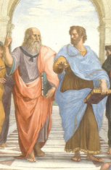
Notes, etc.…

